Slide 1
Power manager telemetry
CHARLES FINNEY ANDREWS D
URK21CS1058

Slide 2
Problem Statement:
In the era of 5G and edge computing, the deployment of devices across different locations has increased, leading to higher power consumption. To address this issue, the government is pushing enterprises and industries to reduce power usage with the goal of achieving net-zero power consumption. Additionally, the rising cost of electricity necessitates a comprehensive understanding of the total power drawn by systems. This project focuses on measuring and analyzing power telemetry data from various system components such as CPU, memory, NIC, and TDP to develop strategies for optimizing power utilization and achieving sustainability goals.

Slide 3
Features Offered:
Real-Time Monitoring: Continuously gather telemetry data from various system components,
including CPU, memory, NIC, and TDP, to provide an up-to-date view of system power utilization.
Dynamic Load Generation: Simulate different levels of system utilization to observe and analyze
power consumption patterns under varying workloads.
Comprehensive Reports: Generate detailed reports on system power utilization based
on the collected telemetry data, highlighting areas of high consumption and potential optimizations.
Visualization: Utilize graphical charts and dashboards to represent telemetry data,
making it easier for users to understand and analyze power consumption trends and patterns.

Slide 4
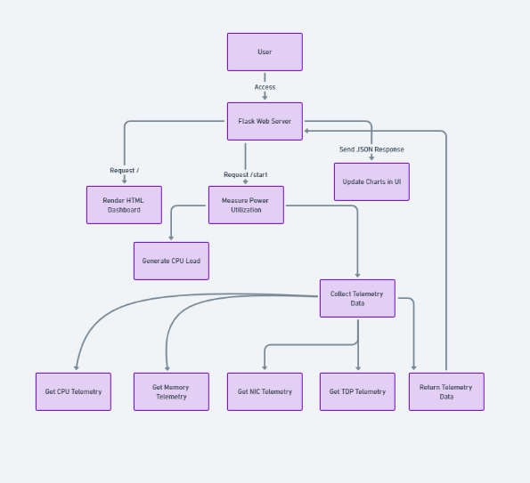
Architecture Diagram:

Slide 5
Process Flow:
Initialize System Monitoring:
Start the Flask application to serve the telemetry dashboard, enabling users to interact with the system and view real-time data.
User Input:
Users provide the desired CPU utilization percentage and duration for the test through a web form on the dashboard.
Load Generation:
The system generates load based on user input to simulate real-world usage scenarios, allowing for the observation of power consumption under controlled conditions.
Telemetry Data Collection:
Collect CPU, memory, NIC, and TDP telemetry data at regular intervals during the load generation period.
Data Storage:
Store the collected telemetry data in a structured format for subsequent analysis and reporting.
Visualization and Reporting:
Visualize the telemetry data using charts and graphs, providing an intuitive way to analyze power consumption.
Generate comprehensive reports summarizing the findings, including insights into system power utilization and recommendations for optimization.

Slide 6
Technologies Used:
Programming Languages: Python
Frameworks: Flask for the web interface, psutil for system monitoring
Visualization Libraries: Chart.js, Bootstrap for UI
Data Analysis: Pandas
Environment: Linux, Docker/Kubernetes (for container orchestration)

Slide 7
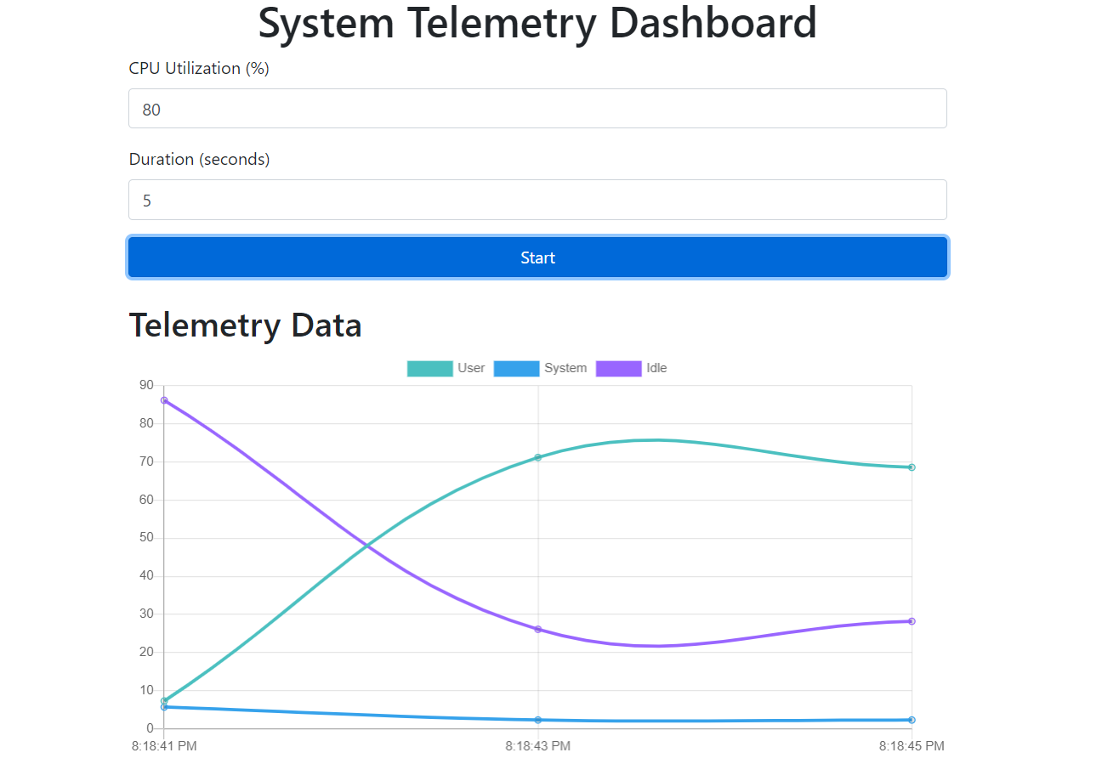
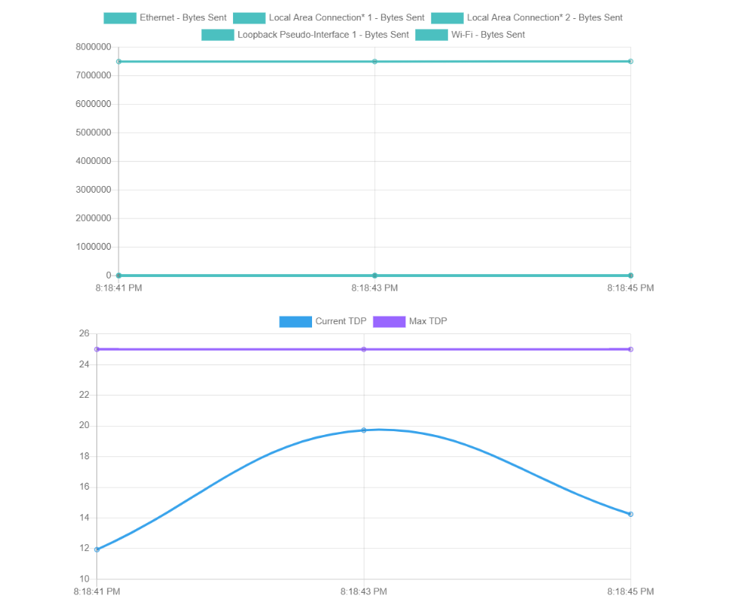
Output:

Slide 8
Conclusion.
The Power Manager Telemetry project aims to address the critical challenge of reducing power consumption in the context of 5G and edge computing. By leveraging open-source tools and methodologies, we can effectively monitor and analyze power utilization across various system components, including CPU, memory, NIC, and TDP. The project not only provides a technical solution for real-time power telemetry but also offers insights into optimizing system performance to achieve sustainability goals. Through this project, participants will gain practical experience in power management and contribute to the broader objective of reducing energy consumption in modern computing environments.

